Slide 1
WHY WIRELESS NETWORK
• Advantages
Spatial flexibility in radio reception range
Ad hoc networks without former planning
No problems with wiring (e.g. historical buildings, fire protection)
Robust against disasters like earthquake, fire – and careless users which remove connectors!
• Disadvantages
Generally very low transmission rates for higher numbers of users
Restricted frequency range, interferences of frequencies

Slide 2
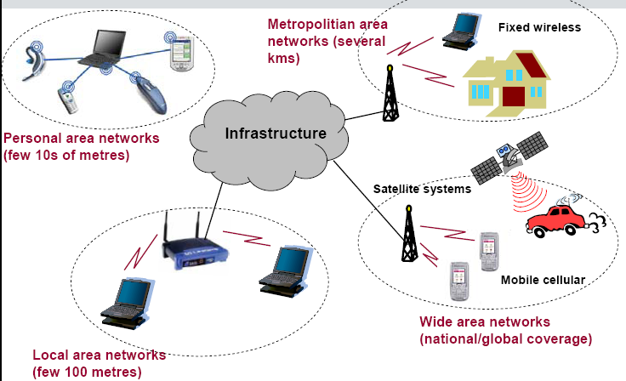
Classification of Wireless Network

Slide 4
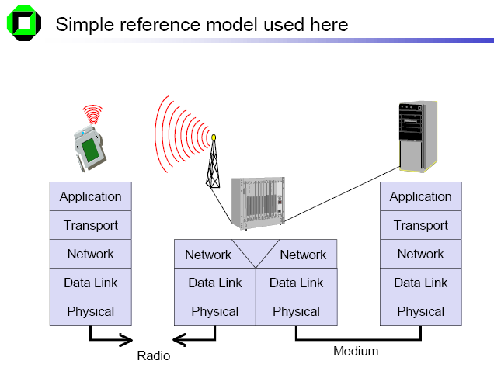

Slide 5
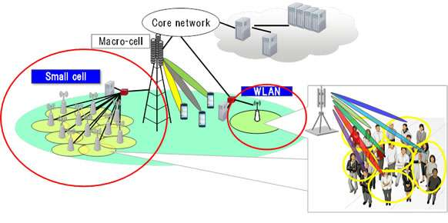
Multiplexing

Slide 6
Multiplexing describes how several users can share a medium with minimum or no interference
One example, is highways with several lanes. Many users (car drivers) use the same medium (the highways) with hopefully no interference (i.e., accidents)

Slide 7
Frequency division multiplexing
subdivide the frequency dimension into several non-overlapping frequency bands. Each channel ki is now allotted its own frequency band. guard spaces are needed to avoid frequency band overlapping.
This scheme is used for radio stations within the same region, where each radio station has its own frequency.

Slide 8
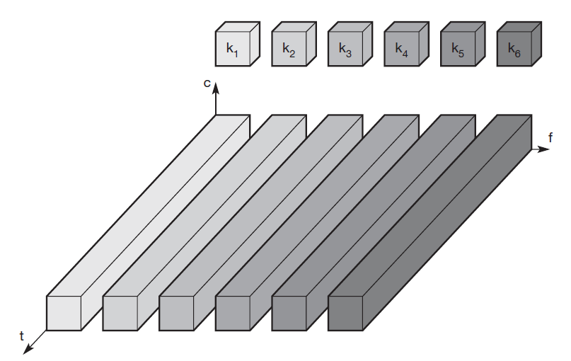

Slide 9
This scheme also has disadvantages
While radio stations broadcast 24 hours a day, mobile communication typically takes place for only a few minutes at a time. Assigning a separate frequency for each possible communication scenario would be a tremendous waste of (scarce) frequency resources

Slide 10
Time division multiplexing
more flexible multiplexing scheme for typical mobile communications is time division multiplexing (TDM).
Here a channel ki is given the whole bandwidth for a certain amount of time. all senders use the same frequency but at different points in time . Again, guard spaces, which now represent time gaps,

Slide 11
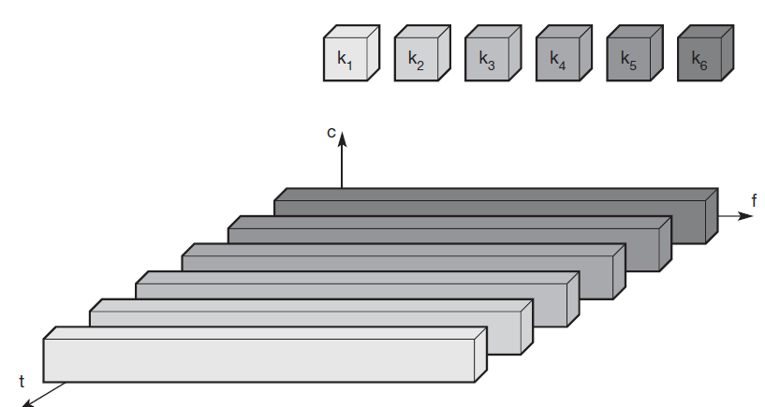

Slide 12
Advantages
Increase Efficiency
Can transmit both voice and data
Less or no interference
Extended battery life
Cost effective for converting into digital

Slide 13
Disadvantage
Predefined time slots
Call Drop
Multipath distortion

Slide 14
Frequency and time division multiplexing can be combined, i.e., a channel ki can use a certain frequency band for a certain amount of time.
Now guard spaces are needed both in the time and in the frequency dimension.

Slide 15
The mobile phone standard GSM uses this combination of frequency and time division multiplexing for transmission between a mobile phone and a so-called base station

Slide 16
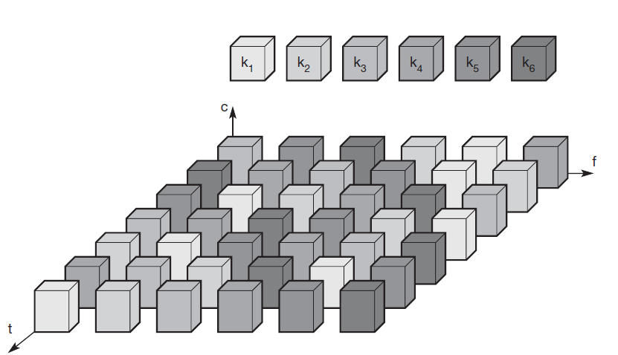

Slide 17
Code division multiplexing
code division multiplexing (CDM) is a relatively new scheme in commercial communication
All channels ki use the same frequency at the same time for transmission

Slide 18
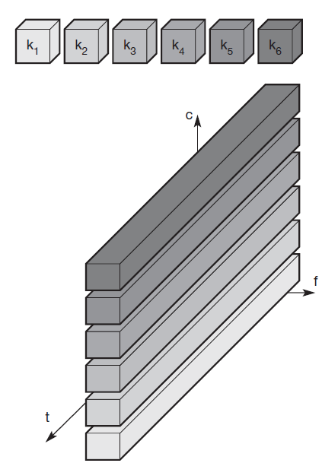

Slide 19
Advantages
Bandwidth Efficient.
Secure.
No coordination and synchronization necessary
Good protection against interference and tapping

Slide 20
Cellular systems
In Cellular systems for mobile communications, Each transmitter, typically called a base station, covers a certain area, a cell.
“Cell radii can vary from tens of meters in buildings, and hundreds of meters in cities”.

Slide 21
Cell Footprint
The actual radio coverage of a cell is known as the cell footprint.
Coverage contour should be circular.
However it is impractical because it provides ambiguous areas with either multiple or no coverage.
Due to economic reasons, the hexagon has been chosen due to its maximum area coverage.
Hence, a conventional cellular layout is often defined by a uniform grid of regular hexagons.

Slide 23
Why hexagon for theoretical coverage?
For a given distance between the center of a polygon and its farthest perimeter points, the hexagon has the largest area of the three
Thus by using hexagon geometry, the fewest number of cells can cover a geographic region, and hexagon closely approximates a circular radiation pattern which would occur for an Omnidirectional BS antenna

Slide 24
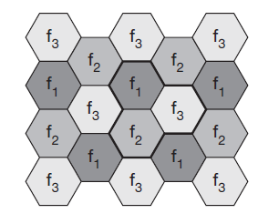
Cellular System

Slide 25
why mobile network providers install several thousands of base stations throughout a country (which is quite expensive) and do not use powerful transmitters with huge cells like, e.g., radio stations, use.

Slide 26
Advantages of cellular systems with small cells are
Higher capacity:
Implementing SDM allows frequency reuse. If one transmitter is far away from another, i.e., outside the interference range, it can reuse the same frequencies.

Slide 27
Less transmission power
A receiver far away from a base station would need much more transmit power than the current few Watts.

Slide 28
Local interference only
Having long distances between sender and receiver results in even more interference problems. With small cells, mobile stations and base stations only have to deal with ‘local’ interference.

Slide 29
Robustness
Cellular systems are decentralized and so, more robust against the failure of single components.

Slide 30
Small cells also have some disadvantages:
Infrastructure needed:
Cellular systems need a complex infrastructure to connect all base stations. This includes many antennas, switches for call forwarding, location registers to find a mobile station etc,

Slide 31
Handover needed:
The mobile station has to perform a handover when changing from one cell to another. Depending on the cell size and the speed of movement

Slide 32
Frequency planning
To avoid interference between transmitters using the same frequencies, frequencies have to be distributed carefully

Slide 33
Frequency reuse
Each cellular BS is allocated a group of radio channels to be used within a small geographic area called cell
BS in adjacent cells are assigned channel groups which contain completely different channels than neighboring cells
By limiting the coverage area to within the boundaries of a cell, the same groups of channels may be used to cover different cells that are separated from one another by distances large enough to keep the interference levels within tolerable limits
The design process of selecting and allocating channel groups for all of the cellular BSs is called frequency reuse or frequency planning

Slide 34
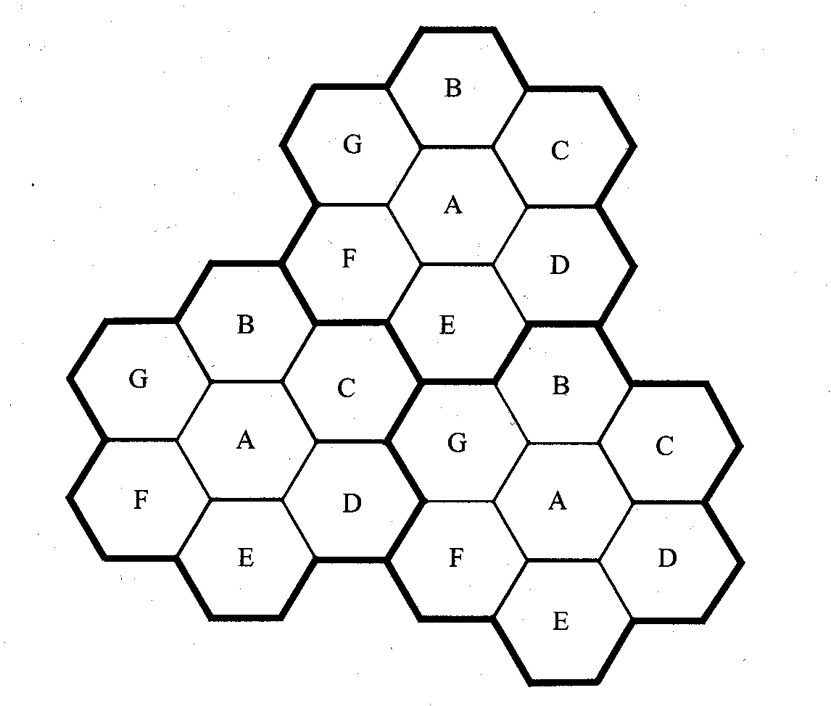
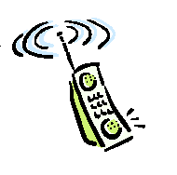
Frequency reuse
By limiting the coverage area to within the boundary of the cell, the channel groups may be reused to cover different cells.
Keep interference levels within tolerable limits.
seven groups of channel from A to G

Slide 35
Frequency Reuse
Consider a cellular system which has a total of S duplex channels.
Each cell is allocated a group of k channels, .
The S channels are divided among N cells.
The total number of available radio channels, S = kN
The N cells which use the complete set of channels is called cluster.
The cluster can be repeated M times within the system. The total number of channels, C, is used as a measure of capacity,
C = MkN = MS

Slide 36
Frequency reuse implies that in a given coverage area there are several cells that use the same set of frequencies
These cells are called co-channel cells and interference between signals from these cells is called co-channel interference
Unlike thermal noise which can be overcome by increasing SNR, co-channel interference cannot be combated by simply increasing the carrier power of a transmitter
To reduce co-channel interference, co-channel cells must be physically separated by a minimum distance to provide sufficient isolation due to propagation

Slide 37
When the size of each cell is approximately the same and the BSs transmit the same power, the co-channel interference ratio is independent of the transmitted power and becomes a function of the radius of the cell (R) and the distance between the centers of the nearest co-channel cells (D)
The parameter Q is called the co-channel reuse ratio is related to the cluster size
For a hexagonal geometry Q=D/R=√(3N)
A small value of Q provides larger capacity since the cluster size is small whereas a large value of Q improves the transmission quality, due to smaller level of co-channel interference

Slide 38
Channel Assignment Strategies
mobile service providers follow strategies which ensure the effective utilization of the limited radio spectrum. With increased capacity and low interference being the prime objectives
A variety of channel assignment strategies have been followed to aid these objectives.

Slide 39
Fixed Channel Assignment (FCA)
In a fixed channel assignment, each cell is allocated a predetermined set of voice channels.
Any call attempt within the cell can only be served by the unused channels in that particular cell.
If all the channels of that cell are occupied, the call is blocked and the subscriber does not receive service
To allocate frequency in such case, various strategies are used.

Slide 40
FCA
If the total number of available channels in the system S is divided into sets, the minimum number of channel sets N required to serve the entire coverage area is related to the frequency reuse distance D as follows:
N = D² / 3R²

Slide 41
Channel borrowing
Channel borrowing strategy in which frequency is borrowed from the neighboring cell.
The MSC supervises such borrowing procedure and ensure that the borrowing of a channel does not disrupt or interfere with any of the cells in progress in the donor cell.
Borrowing can be done from an adjacent cell which has largest number of free channels (borrowing from the richest)
Select the first free channel found for borrowing using a search algorithm (borrow first available scheme)
Return the borrowed channel when channel becomes free in the cell (basic algorithm with reassignment)

Slide 42
Channel Borrowing (CB) Schemes
Donor Cell for Sector X
Cell 3
1
2
X
Y
Z
A call initiated in the sector X of cell 3 can borrow a channel from adjacent cells 1 or 2.

Slide 43
Channel Borrowing (CB) Schemes
Scheme | Description
Simple Borrowing (SB) | A nominal channel set is assigned to a cell, as in the FCA case. After all nominal channels are used, an available channel from a neighboring cell is borrowed.
Borrow from the Richest (SBR) | Channels that are candidates for borrowing are available channels nominally assigned to one of the adjacent cells of the acceptor cell. If more than one adjacent cell has channels available for borrowing, a channel is borrowed from the cell with the greatest number of channels available for borrowing.
Basic Algorithm (BA) | This is an improved version of the SBR strategy which takes channel locking into account when selecting a candidate channel for borrowing. This scheme tried to minimize the future call blocking probability in the cell that is most affected by the channel borrowing.
Basic Algorithm with Reassignment (BAR) | This scheme provides for the transfer of a call from a borrowed channel to a nominal channel whenever a nominal channel becomes available.
Borrow First Available (BFA) | Instead of trying to optimize when borrowing, this algorithm selects the first candidate channel it finds.

Slide 44
In dynamic channel assignment strategy channels are temporarily assigned for use in cells for the duration of the call. Each time a call attempt is made from a cell the corresponding BS requests a channel from MSC. The MSC then allocates a channel to the requesting the BS. After the call is over the channel is returned and kept in a central pool. To avoid co-channel interference any channel that in use in one cell can only be reassigned simultaneously to another cell in the system if the distance between the two cells is larger than minimum reuse distance.
Dynamic Channel Allocation

Slide 45
DCA
DCA schemes can be centralized or distributed.
The centralized DCA scheme involves a single controller selecting a channel for each cell
The distributed DCA scheme involves a number of controllers scattered across the network (MSCs).
Centralized DCA schemes can theoretically provide the best performance. However, the enormous amount of computation and communication among BSs leads to excessive system latencies and renders centralized DCA schemes impractical. Nevertheless, centralized DCA schemes often provide a useful benchmark to compare practical decentralized DCA schemes.

Slide 46
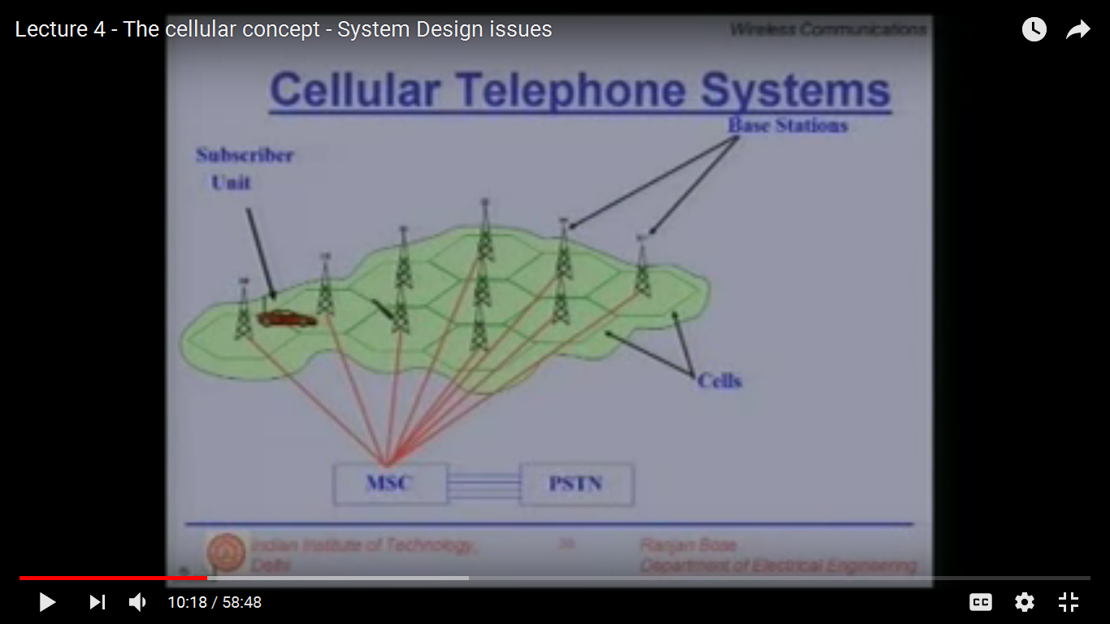

Slide 47
Comparison between FCA and DCA
FCA | DCA
Performs better under heavy traffic Low flexibility in channel assignment Maximum channel reusability Sensitive to time and spatial changes Not stable grade of service per cell in an interference cell group High forced call termination probability Suitable for large cell environment Low flexibility | Performs better under light/moderate traffic Flexible channel allocation Not always maximum channel reusability Insensitive to time and time spatial changes Stable grade of service per cell in an interference cell group Low to moderate forced call termination probability Suitable in microcellular environment High flexibility

Slide 48
Comparison between FCA and DCA
FCA | DCA
Radio equipment covers all channels assigned to the cell Independent channel control Low computational effort Low call set up delay Low implementation complexity Complex, labor intensive frequency planning Low signaling load Centralized control | Radio equipment covers the temporary channel assigned to the cell Fully centralized to fully distributed control dependent on the scheme High computational effort Moderate to high call set up delay Moderate to high implementation complexity No frequency planning Moderate to high signaling load Centralized, distributed control depending on the scheme

Slide 49
Hybrid Channel Allocation (HCA)
HCA schemes are the combination of both FCA and DCA techniques.
In HCA schemes, the total number of channels available for service is divided into fixed and dynamic sets.
The fixed set contains a number of nominal channels that are assigned to cells as in the FCA schemes and, in all cases, are to be preferred for use in their respective cells.
The dynamic set is shared by all users in the system to increase flexibility.
Example: When a call requires service from a cell and all of its nominal channels are busy, a channel from the dynamic set is assigned to the call.

Slide 50
Hybrid Channel Allocation (HCA)
Request for a channel from the dynamic set is initiated only when the cell has exhausted using all its channels from the fixed set.
Optimal ratio: ratio of number of fixed and dynamic channels.
3:1 (fixed to dynamic), provides better service than fixed scheme for 50% traffic.
Beyond 50% fixed scheme perform better.
For dynamic, with traffic load of 15% to 32%, better results are found with HCA.

Slide 51
